Slide 1
Smart Home Network Management with Dynamic Traffic Distribution
Chenguang Zhu
Xiang Ren
Tianran Xu

Slide 2
Motivation

Slide 3
Motivation – Per Application QoS
In small home / office networks,
applications compete for limited bandwidth
high bandwidth consumption applications can be disruptive
Eg. bitTorrent
To ensure fairness,
different application flows should be given different priorities
Eg. High priority for important Skype meeting
Eg. Low priority for bitTorrent download
Need traffic adjustment based on flow types
Notes:
The goal of our project is to provide Per Application QoS.
When we are at home or under an office setting, we notice that different applications often compete for limited bandwidth.
Under such settings, high bandwidth consumption applications, such as bitTorrent downloads, can be disruptive to other applications.
To ensure fairness, different application flows should be given different priorities
Eg. High priority for important Skype meeting
Eg. Low priority for bitTorrent download
Therefore we need traffic adjustment based on flow types.
-------------------------------------------------
Home networks are increasingly composed of a large number of devices, running a great variety of applications. However, not all applications are of equal priorities. For example, a parent might decide that a video conference call is more important than her teenager’s torrent download session, and therefore would want to ensure the quality of the video conference call at the cost of sacrificing the torrent downloading speed. One common solution to achieve some level of traffic control is for the parent to install QoS rules on the router, but doing so only offers limited flexibility - it uses a limited number of rules such as port numbers to decide the type of flow. A malicious application could, for example, tweak its port number to circumvent bandwidth limitations. As a result, a comprehensive inspection scheme is needed to provide more accurate QoS rules, such as one that studies the payload content of the packet. And the flexibility of software-defined networking allows one to implement such complex inspection logic in the software controller.

Slide 4
Motivation – Per Application QoS
Flow identification is difficult in traditional networks
SDN allows novel flow identification techniques
Deep packet inspection
Machine learning based techniques
Use flow rules to easily adjust traffic
Notes:
To improve the current state of home network traffic control, our team proposes to use a software-defined controller to perform smart flow type identification and use traffic engineering to allocate bandwidth for different types of application flows accordingly. Specifically, the controller needs to read in and inspect each packet for a flow, and classify its type. The controller then needs to push a bandwidth controlling rule to the switch for the type of flow for traffic engineering.

Slide 5
System Design
Notes:
This part is the system design of our project.

Slide 6
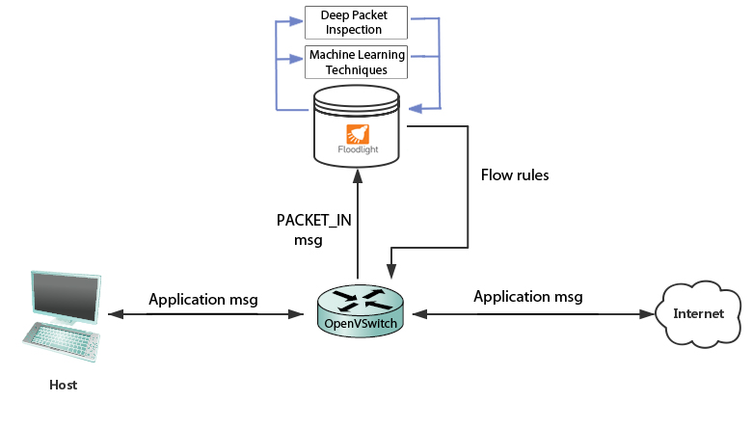
Design – System Overview
Notes:
This is an overview of our system design. We develop a module on Floodlight controller. Controller receives PACKET_IN message from the switch, uses our module to identify the application type of the flow,
Then according to the application type, controller pushes different flow rules to the switch.

Slide 7
Flow Identification – Commonly Used Techniques
Shallow packet inspection
Inspect packet header, eg. port-number, protocol
Low accuracy, application circumvention
Deep packet inspection
Inspect data part of a packet, high accuracy
Sometimes maintain a big database of packet features
Frequently update rules for new applications
Notes:
This part is the design of flow identification. The commonly used flow identification techniques include shallow packet inspection and deep packet inspection.
Shallow packet inspection identify packets by inspecting header fields such as port number.
It has low accuracy because many applications can change their port numbers.
So we won’t use it.
Deep packet inspection identify packets by inspecting data part of packets.
It has high accuracy because it has specific rules for identifying specific type of protocols.
But sometimes you need to maintain a big database for application flow features.
And you need to update the rules frequently.
For our system, we write some simple rules to implement simple deep packet inspection function, but this is not our main approach.

Slide 8
Flow Identification – Machine Learning
Machine learning based-techniques <<< We focus on this one
Novel techniques
Cross-disciplinary
Interesting experiments
eg. Clustering vs classification algorithms
Notes:
In our implementation, We focus on using machine learning to identify packets of different application flows.
This is a novel idea and it is a cross-disciplinary approach.
We did some interesting experiments on this method. For example, we already used clustering and classification machine learning algorithms to identify the flow type.
We will show our experiment result in later part of the slides.

Slide 9
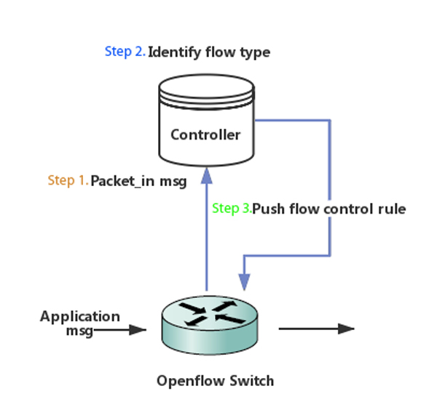
Design - Traffic Adjustment
Assign different priority based on flow type
Notes:
The next part of our system design is the traffic adjustment.
After our module on controller identifies the flow type, we push a new rule to the switch and set priority for this flow entry.

Slide 10
Implementation
Floodlight + Mininet + OpenVSwitch
Notes:
The next part is our implementation of project.
We use Floodlight as the basis of our controller, use Mininet to build Topology and use OpenVSwitch as switch.

Slide 11
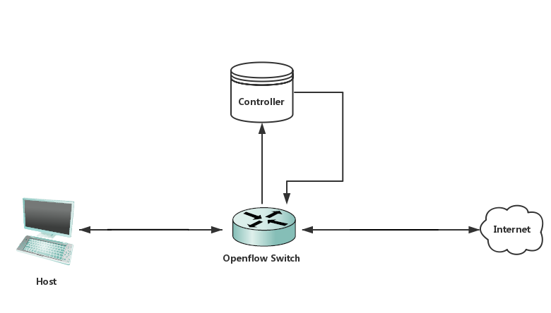
Implementation –Simple Test Topology
Notes:
This picture shows one quite simple topology we built on Mininet.
In the beginning steps of project, we use it for our experiments.
It includes one host, one switch and one controller. One interface of the switch connects to host and the other interface connects to Internet.

Slide 12
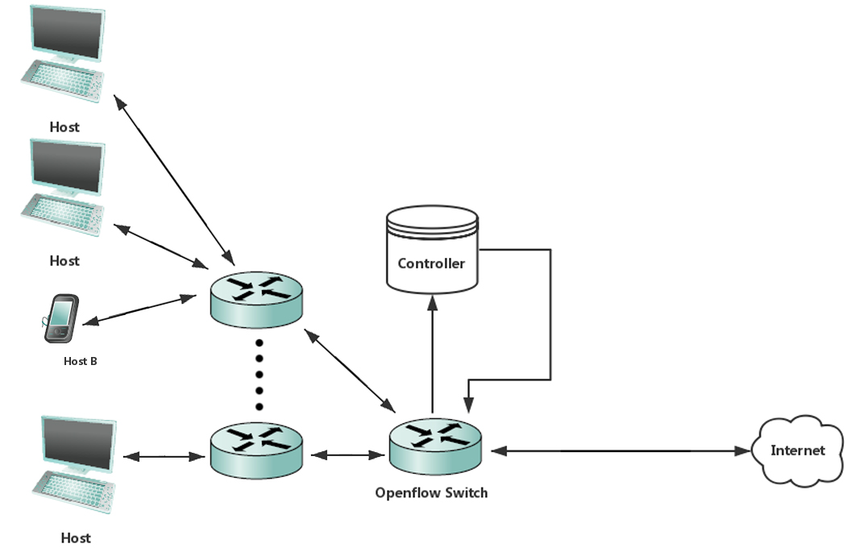
Implementation –Realistic Topology
Notes:
We are trying to adapt our system to more realistic topologies such as the one shown in the picture.
In a realistic topology, there could be a large number of different types of hosts. And there could be more interconnecting switches.

Slide 13
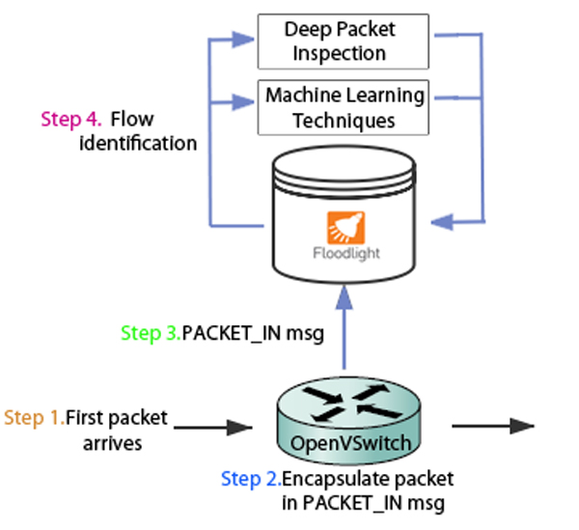
Implementation – Packet Arrival and Identification
Notes:
This is our implementation of packet arrival and identification.
In the first step, The first packet of a flow arrives at the switch,
then switch sends the PACKET_IN message to controller which contains the original packet,
Our own module on Floodlight keeps listening to PACKET_IN message.
When this message come, we start to analyze packet, using deep packet inspection function or machine learning methods.

Slide 14
Implementation – Deep Packet Inspection
Inspects data part of a packet
Use simple rules to identify packet type
Protocol | Data part features
HTTP | contains ‘GET’ ‘DELETE’ ‘POST’ ‘PUT’ …
SSH | start with ‘SSH-’
OpenVPN | first two bytes stores packet length – 2
… | …
Notes:
As I said before, in our module, we use two kinds of techniques to identify the application type of a packet.
The first technique is deep packet inspection. This is not our main approach so we just write simple rules to do identification.
For example, if the beginning of data part of packet contains some bytes like “GET”, “POST”, “PUT” , we consider it as HTTP.
If the data part starts with “SSH-”, we consider it as SSH.
If the value of first two bytes of data part equals packet length minus 2, then we consider it as OpenVPN.
And some simple rules like this.

Slide 15
Implementation – Machine Learning Techniques
Clustering vs Classification
Clustering:
Use K-Means algorithm
Classification:
Use SVM algorithm
Notes:
The second kind of techniques we use to identify flow type is machine learning methods.
In our experiments so far, we have tried clustering and classification algorithm for identifying packets.
For clustering, we use Kmeans algorithm.
And for classification, we use SVM algorithm.

Slide 16
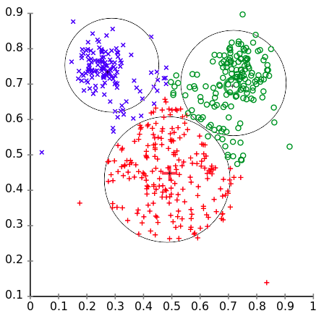
Clustering – K-Means
groups data points into k clusters,
each point belongs to the cluster with the nearest mean
Source: https://en.wikipedia.org/wiki/K-means_clustering
Notes:
1. CONCEPT Here is some simple ML concepts that Id like to introduce for you to understand our work better.
2. KMEAN For clustering, we use Kmeans algo
As you can see in the picture, it

Slide 17
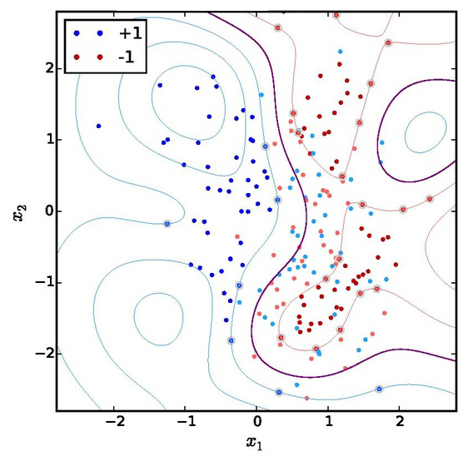
Classification - SVM
assigns data points into categories,
based on data vectors nearest to the category boundaries
Source: https://en.wikipedia.org/wiki/Support_vector_machine
Notes:
1. SVM For classification, we use S.V.M.
As you can see in the pic, it …

Slide 18
Dataset Selection
Publically available research traces
eg. waikato traces (http://wand.net.nz/wits/catalogue.php)
Pros: representative traffic workloads
Cons: too complex, hard to label packet type
Self collected traces
Self generated packets, captured on WireShark
Easy to label
Notes:
1. NEED TRAIN We needed to input training data to our machine learning algos.
2. HARD SELECTION But selecting the input dataset is not trivial.
3. TWO CHOICEs We had two choices, one its to … …
The other is to … …

Slide 19
Feature
Commonly used features from research literature
Source: T. Nguyen and G. Armitage. “A Survey of Techniques for Internet Traffic Classification using Machine Learning” IEEE Communications Surveys and Tutorials 01/2008; 10:56-76.
Features
Total number of packets per flow
Flow duration
Packet lengths statistic (min, max, mean, std dev.) per flow
Payload lengths
Payload content (We use first N number of bytes of payload as feature)
…
Notes:
1. FEATURE We also needed to select features to train on for the ML algos
2. LITERATURE Here are some of the common features used in research literature.
3. PAYLOAD We chose to use the payload, to be more specific …
4. VARY BYTES And we varied the number of bytes to see how our model’s performance changes according to the length
And select the best length

Slide 20
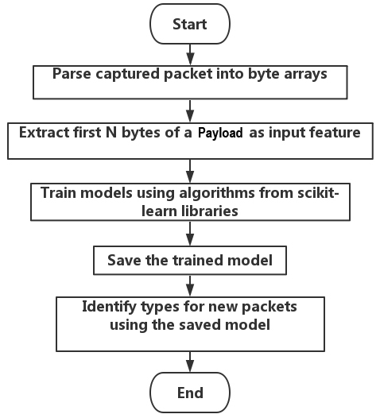
Machine Learning Based Identification
Notes:
1. HAVE FEATURE & INPUT, Now that we have the feature and input we can build the prediction model
Here are the steps taken to train a machine learning model and identify packets:
Step 1. parse captured packet into byte arrays
Step 2. extract first N bytes of a packet’s payload as input feature *** TCP 52 UDP 42
Step 3. train models using algorithms from scikit-learn libraries
Step 4. save the trained model
Step 5. identify types for new packets using the saved model

Slide 21
Performance of Identification – K-Means
K-means 2 bytes
Notes:
RESULT Here are the results we gathered from kmeans algorithm.
EVALUATED on 4 kinds of flows: http, ssh, skype and bittorrent
3. 8 GROUPS We specified for the kmeans algorithm to group input packets into 8 clusters according to the first 2 bytes of the TCP or UDP payload.
4. NO LABEL The kmeans algorithm does not require us to prelabel the type of packets, rather, it groups packets based on their statistical similarity.
And here are the results.
5. WHY 8 CLUSTERS NOT 4 WHY 8 clusters, more accurate
1. FIRST SKYPE As we can see, the first cluster consists primarily of of packets from skype, and
2. SECOND SHH In the second cluster, ssh packets are the majority, but it also contains a significant amount of bittorrent packets.
SO CLUSTER2 IS LESS accurate THAN CLUSTER 1
A cluster is more accurate when it contains primarily of one kind of packet.
3. INTERSTING bitTorrent Interestingly, bitTorrent packets does not have its own majority, and is confused with ssh, http, and skype packets.

Slide 22
Performance of Identification – K-Means
K-means 3 bytes
Notes:
1. 3Bytes Here are the results where we use 3 bytes of data.
2. BITTORRENT BETTER Notice how bitTorrent packets can now be clearly grouped into two clusters,
3. SSH HTTP WORSE Whereas the clusters for http and ssh packets become less distinguishable.

Slide 23
Performance of Identification – K-Means
K-means 4 bytes
Notes:
The performance for 4 bytes are similar to using 3 bytes.

Slide 24
Performance of Identification – K-Means
K-means 8 bytes
Notes:
1. 8BYTES IMRPOVE SIG When we increased to 8 bytes, the results improve significantly.
As we can see in the picture,
2. CLEAR MAJORITY All protocols now clearly have its majority cluster.
Cluster 1 and 5 are bittorrent clusters,
Cluster 2 and 6 are http clusters
cluster 4 and 8 are ssh clusters,
Cluster 4 and 7 are skype clusters.

Slide 25
Performance of Identification – K-Means
K-means 10 bytes
Notes:
1. SIMILAR to 8 The performance of 10 bytes input data is similar to that of 8 bytes.
2. NO LABEL Here we do not label the data and simply let the algorithm decide their similarities.
3. BYTES -> PEFORMANCE But as we vary the number of bytes the performance can also gets affected significantly.
4. APP SPECIFIC in first N BYTES This phenomenon seems to suggest that indeed there are some application specific information in the first few bytes of the TCP or UDP payload for these packets.

Slide 26
Performance of Identification – Varying Feature Length
Notes:
1. 2nd SVM A second method we use for machine learning is S.V.M.
2. RATE of CORRECT IDENTIFICATION Shown in the picture here are the rate of correct identification for the k means and and SVM.
5. SVM can be much MORE ACCURATE than kmeans, giving a best correct rate of almost 90%. Best almost 80 for svm
3. SVM BEST WHEN FEWER BYTES Interestingly, SVM performs best when there are fewer number of bytes, and deteriorates when the number of bytes increases beyond 4.
4. KMEAN BEST: 8 However, the performance for kmeans peaks around 8 bytes.
We do not yet know the reason for this phenomenon.

Slide 28
K-means port# + 2 bytes data

Slide 29
K-means port# + 3 bytes data

Slide 30
K-means port# + 4 bytes data

Slide 31
K-means port# + 8 bytes data

Slide 32
K-means port# + 10 bytes data

Slide 33
Notes:
1. 2nd SVM A second method we use for machine learning is S.V.M.
2. RATE of CORRECT IDENTIFICATION Shown in the picture here are the rate of correct identification for the k means and and SVM.
5. SVM can be much MORE ACCURATE than kmeans, giving a best correct rate of almost 90%. Best almost 80 for svm
3. SVM BEST WHEN FEWER BYTES Interestingly, SVM performs best when there are fewer number of bytes, and deteriorates when the number of bytes increases beyond 4.
4. KMEAN BEST: 8 However, the performance for kmeans peaks around 8 bytes.
We do not yet know the reason for this phenomenon.

Slide 37
Performance of Identification – Varying Sample Size
Notes:
1. SECOND EXPERIMENT VARY SAMPLE SIZE
Here we compare the performance of the algorithm to the number of sample packets.
Different sample sizes do not seem to have a clear effect on K means.
Whereas the accuracy of SVM increases as the number of sample increases.

Slide 38
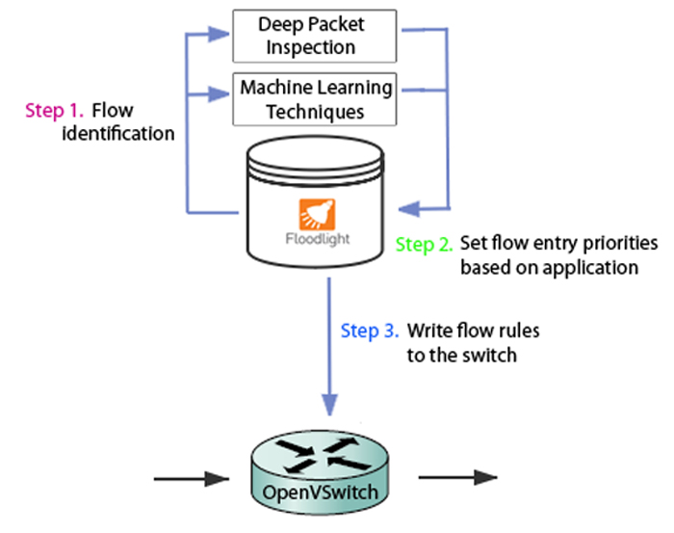
Implementation – Traffic Adjustment
Next step, direct flows through paths with different bandwidth for QoS
Notes:
The next part is our implementation of traffic adjustment.
After we identify the flow type, we set different priorities for flow entry based on application type. Then we write flow rules to the switch.
Actually, setting flow entry priorities doesn’t really affect the bandwidth allocated to the flow, We use it just to show our adjustment of flows.
It’s hard to really control bandwidth of a flow in sdn because even you write complex rules, the underlying switches may not be able to support it.
One possible way we can actually control the rate of a specific flow is that if we have multiple paths then we can direct a flow to another path which has different link rates.

Slide 39
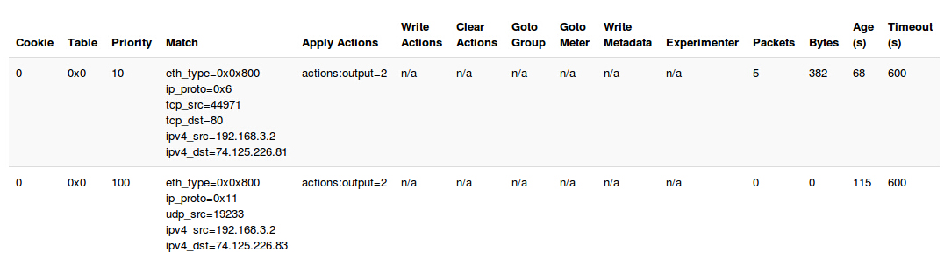
Implementation – Flow Rules
Notes:
Here are two examples of our flow rules.
They are on our flow table showed on Floodlight web UI.
As we can see, the first rule matches the source IP, destination IP, TCP source and destination port, Transport protocol type and Network layer protocol type. The action is to send packets to interface 2.
For this entry we set the priority equals 10.
The second rule matches the source IP, destination IP, UDP source port, Transport protocol type and Network layer protocol type. The action is to send packets to interface 2. we give it a priority of 100.

Slide 40
Challenges - Floodlight
Numerous obstacles encountered!
Unstable releases – last stable release was in 2013!
Outdated, incomplete documentation
Obscure APIs, silent failures, very hard to know what we did wrong
Had to spend 20+ hours reading its source code for debugging
Actively communicating with Floodlight developers did help us
Notes:
In this part we talk about some challenges we encountered when doing this project.
We find that Floodlight has some flaws. The latest stable version of Floodlight was released 2 years ago.
The documentation of Floodlight Java API is kind of outdated and incomplete.
We got silent failures and couldn’t locate the bugs so we have to read a lot of source code of Floodlight.
To solve some strange problems, we sent emails to the developers of Floodlight several times and received their response. That helps.

Slide 41
Challenges – Machine Learning
Hard to choose representative input dataset
Research traces are too complicated
Hard to choose good feature
Bug in Wireshark prevents exporting packets with certain protocols
eg. doesn’t work for dropbox protocol “db-lsc”
Notes:
We also got challenges when we firstly use machine learning methods. At first we want to use trace data provided by other researchers. But we found these traces were too complicated so we decided to produce our own training data.
It is also hard to decide which feature to use in our experiment.
Firstly we also wanted to analyze some dropbox protocol such as “db-lsc” but when we captured packets for training model, we found that wireshark has problem that cannot save this kind of packets. This is another difficulty.

Slide 42
Limitations
Trace not representative & realistic:
Only 4 kinds of flows used for training
- in real life 100s of different flows
Limited training size: 12000 packets
Packets sampled from contiguous time durations
To be improved in future work

Slide 43
Summary
We use deep packet inspection and novel machine learning techniques
Can accurately identify flows of different applications types
Best result 87.5% using SVM, 79% using K-Means on test sets
Can differentiate traffic from Skype and BitTorrent for the traffic we sampled, which Wireshark cannot tell apart.
Can push rules with different priorities to show our control for different application traffics

Slide 44
Future Work
Test on more application types
eg. OpenVPN, Media applications
Try additional machine learning algorithms,
eg. Neural networks, Mixture of Gaussians
Build more realistic topologies to test our framework
More hosts, more switches…

Slide 45
Thanks! Any Questions?

